Slide 1
Final Project Computer Vision (600.461)
N. Belcher, J. Hong, R. Xu

Slide 2

Challenges
Shaky Video
Classification
Multiple Classes
Cars
Taxis, Cars, Motorcycles, Buses
Bicyclists
Pedestrians
Scale, Orientation, and Color

Slide 3
Approach
Video Stabilization
Background Subtraction
Motion Detection
Tracking
Classification

Slide 4
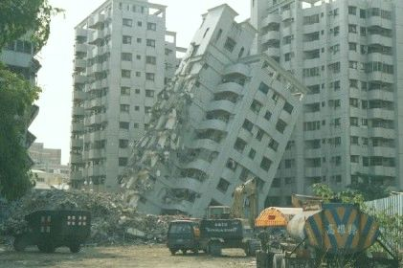
Video Stabilization
Goal: warp frames [2…n] onto frame 1.
Compute SIFT features for every frame.
Compute a homography h that corresponds points in frame i to points in frame 1.
Use h to warp frame i onto the frame 1 space.
Not this much shaking thankfully

Slide 5
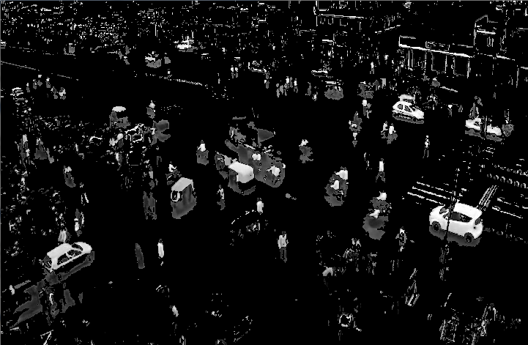

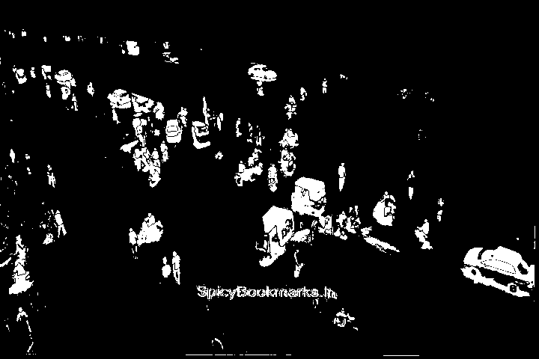
Background Subtraction
Calculate the background (static parts of the video) using mean or median image.
Subtract the background from every frame.
ENHANCE!
Before Stabilization
After Stabilization

Slide 6
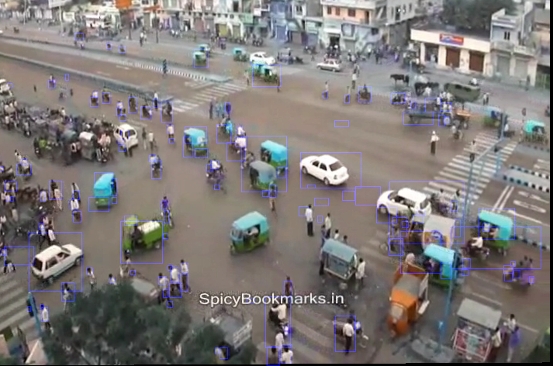

Detection
Detect all the objects in the background subtracted image
Find all the things!
All detected objects

Slide 7
Tracking
Step 1: Tracking
-Update all the objects already being tracked
Step 2: Registration
-Update the objects being registered and begin tracking them.
-Register the rest of the detected objects

Slide 8

Classification
Training Data
RGB Color Matching
Not sure if person,
or concrete…

Slide 9
Current Results
Embed Video Here

